Slide 1


Basis Data
MariaDB / MySQL

Slide 2

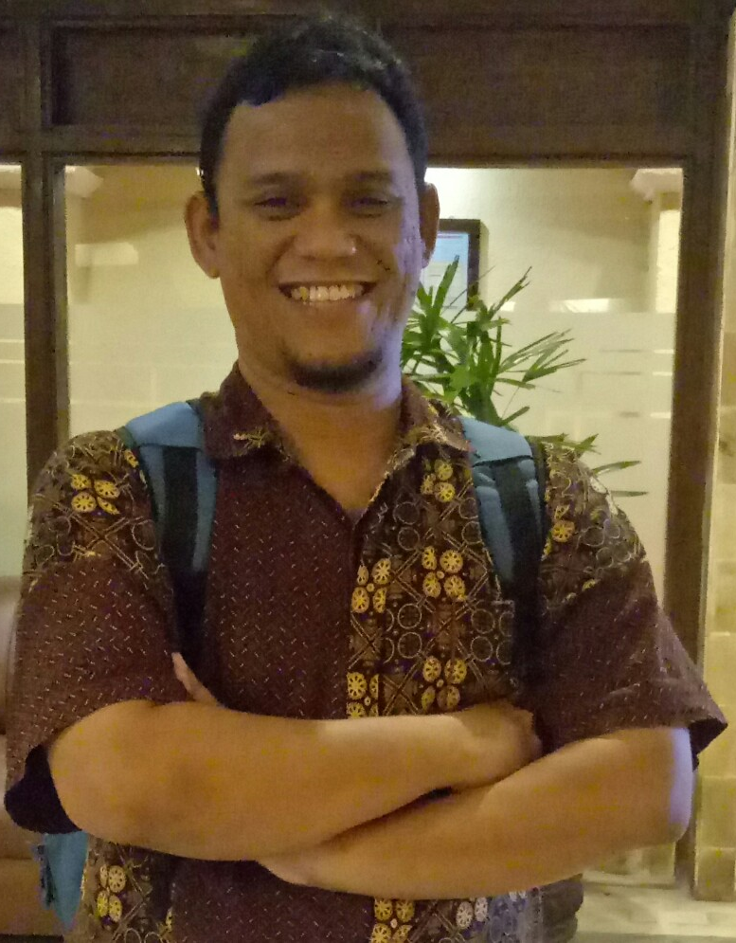
Nasrul, S.Pd.I, S.Kom, M.Kom
Dosen Tetap STT-NF
Instruktur IT NF Computer
Instruktur IT Sekolah Programmer YBM PLN
Instruktur IT Fast Com
nasrul99@gmail.com

Slide 3
Trigger
TRIGGER adalah kumpulan kode SQL yang berjalan secara otomatis untuk mengeksekusi perintah INSERT, UPDATE, DELETE.
Biasanya TRIGGER akan dijalankan sebelum atau sesudah proses INSERT, UPDATE, DELETE (Perintah DML)

Slide 4
Syntax Trigger
DELIMITER $$
CREATE TRIGGER nama_trigger
{BEFORE | AFTER} {INSERT | UPDATE| DELETE }
ON nama_table
FOR EACH ROW
BEGIN
KODE SQL
END$$
DELIMITER ;

Slide 5
Contoh Trigger – Kurangi Stok
DELIMITER $$
CREATE OR REPLACE TRIGGER kurangiStok
AFTER INSERT ON pesanan
FOR EACH ROW
BEGIN
UPDATE produk SET stok = stok - NEW.jumlah WHERE id = NEW.produk_id;
END$$
DELIMITER ;

Slide 6
Contoh Trigger – Update Stok
DELIMITER $$
CREATE OR REPLACE TRIGGER updateStok
AFTER UPDATE ON pesanan
FOR EACH ROW
BEGIN
UPDATE produk SET stok = (stok + OLD.jumlah) - NEW.jumlah
WHERE id = OLD.produk_id;
END$$
DELIMITER ;

Slide 7
Contoh Trigger – Normalisasi Stok
DELIMITER $$
CREATE OR REPLACE TRIGGER normalisasiStok
AFTER DELETE ON pesanan
FOR EACH ROW
BEGIN
UPDATE produk SET stok = stok + OLD.jumlah WHERE id = OLD.produk_id;
END$$
DELIMITER ;

Slide 8
Referensi
https://www.mariadb.org/
https://www.tutorialspoint.com/mariadb/
https://www.javatpoint.com/mariadb-tutorial/

